Slide 1

L4/5 Group 1
Alice Baker
Dragos Liche
Kenneth Pirkle
Jordan Carman
Notes:
Alice

Slide 2
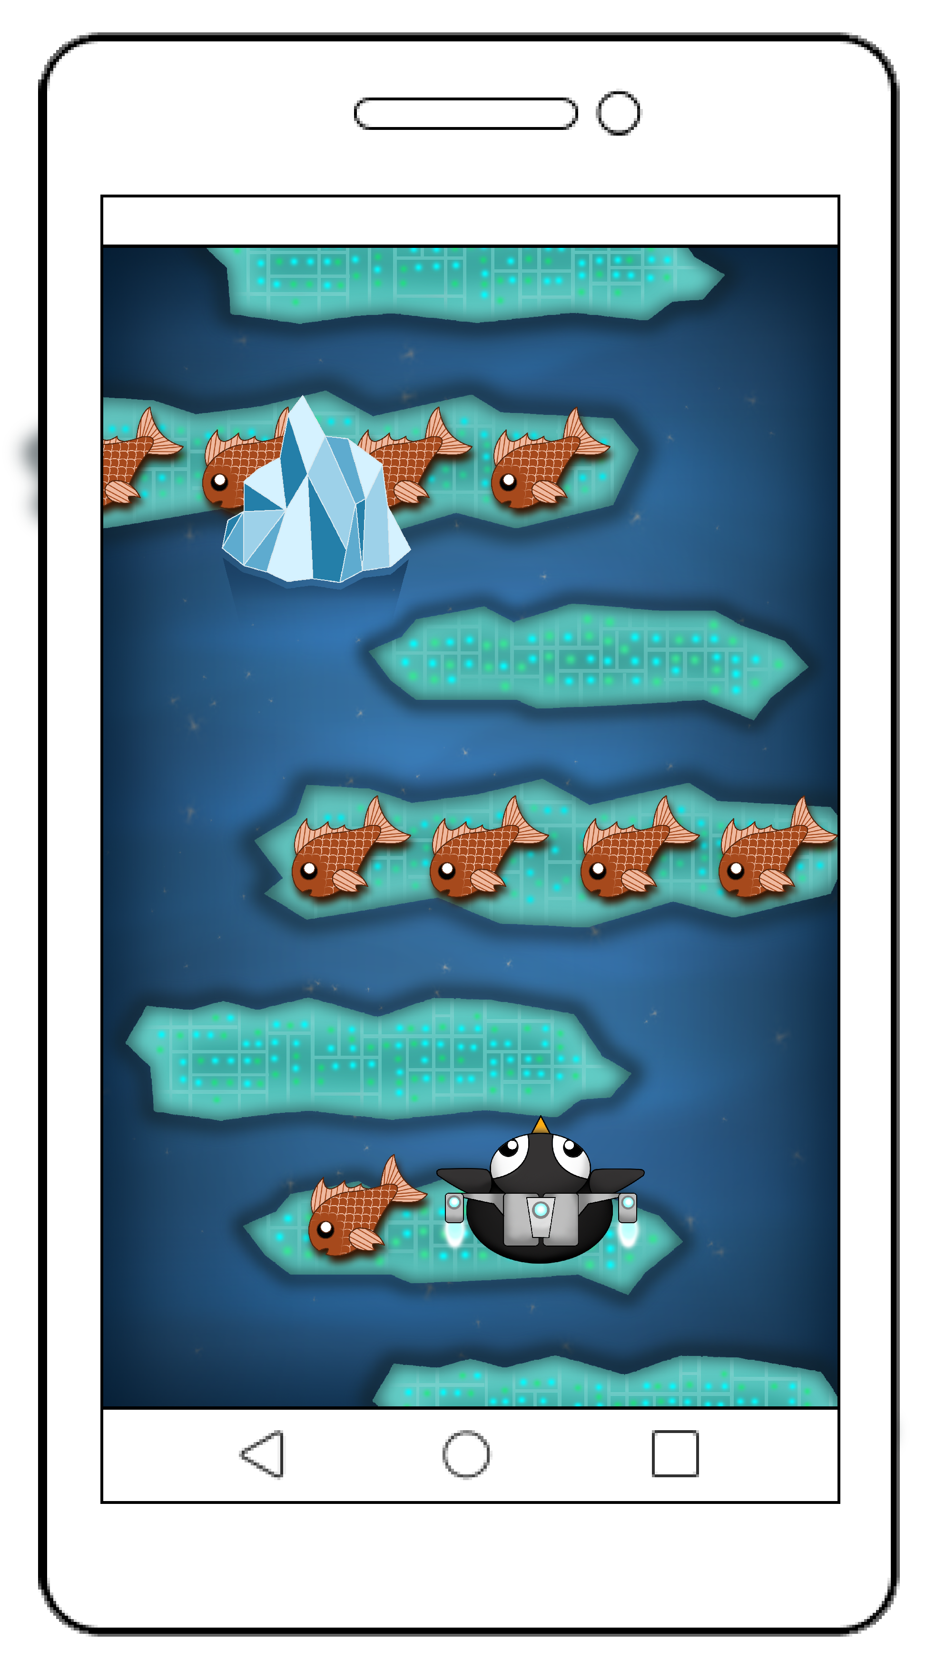
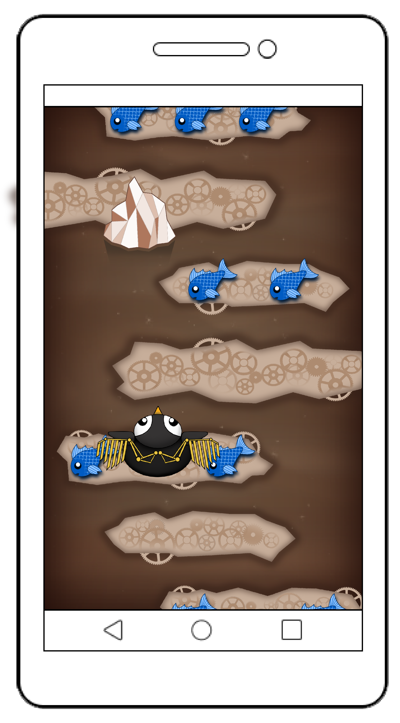
The game
Player 1 theme
Player 2 theme
2D Game
Single tap (twitch) mechanic
2 player on a single mobile device
Symmetric gameplay
Notes:
Jordan or Ken

Slide 3
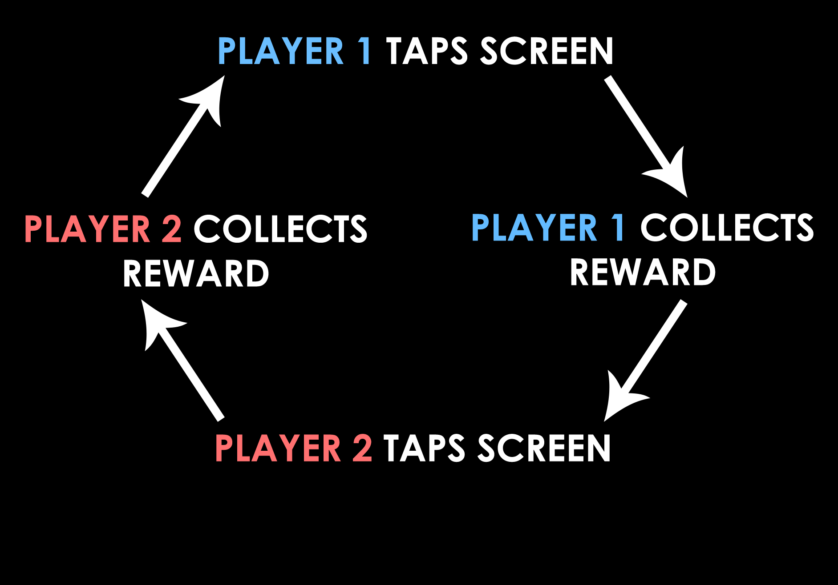
Core game loop
Notes:
Jordan or Ken

Slide 4









gamePLAY
Collect points in a limited time
Best of three rounds
Points decrease if character
misses platform
Collect power-ups
Notes:
Jordan or Ken

Slide 5
eMOTIONS
‘People fun’ – players compete by sabotaging each other
‘Hard fun’ – progressively, challenging gameplay.
‘Fiero’
‘Schadenfreude’
‘Amusement’
Notes:
Dragos

Slide 6
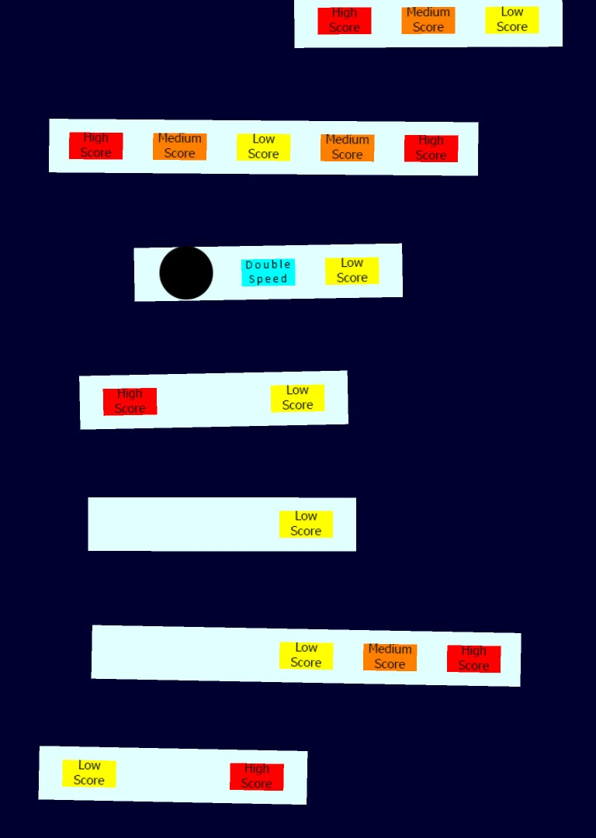
Playtesting
Previously...
Players didn’t know how to play
Around 2 minutes of gameplay
Liked the power-up, would like to see more
Camera was too slow
Didn’t understand pick-ups
Notes:
Alice

Slide 7

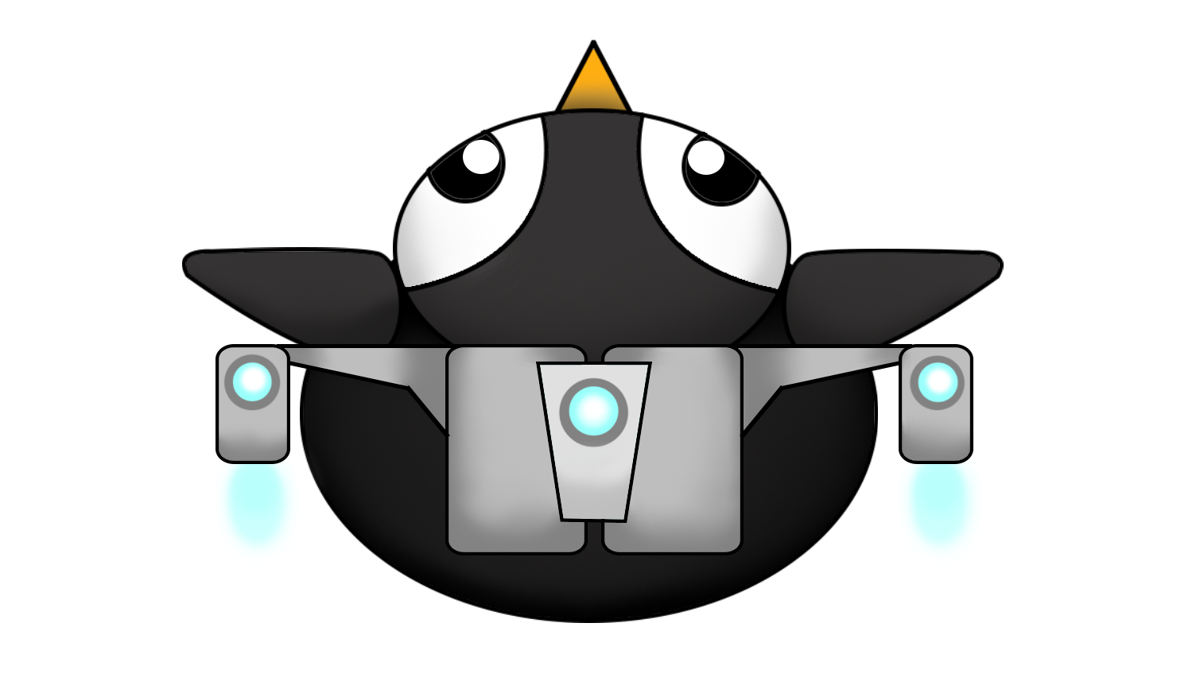
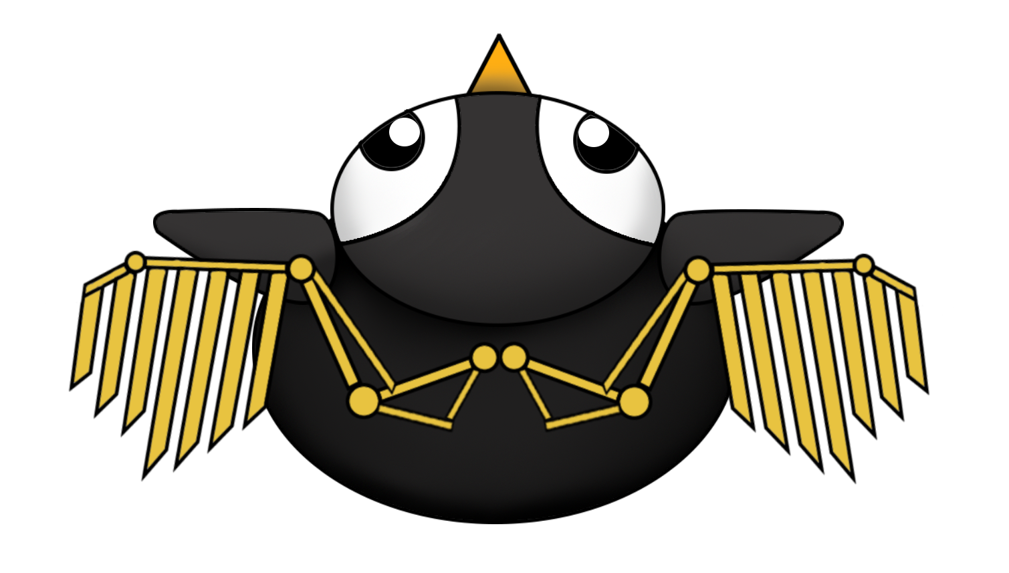
Playtesting iteration
Contrasting artwork
Scoring and rounds
More power-ups
Progression
Notes:
Alice

Slide 8
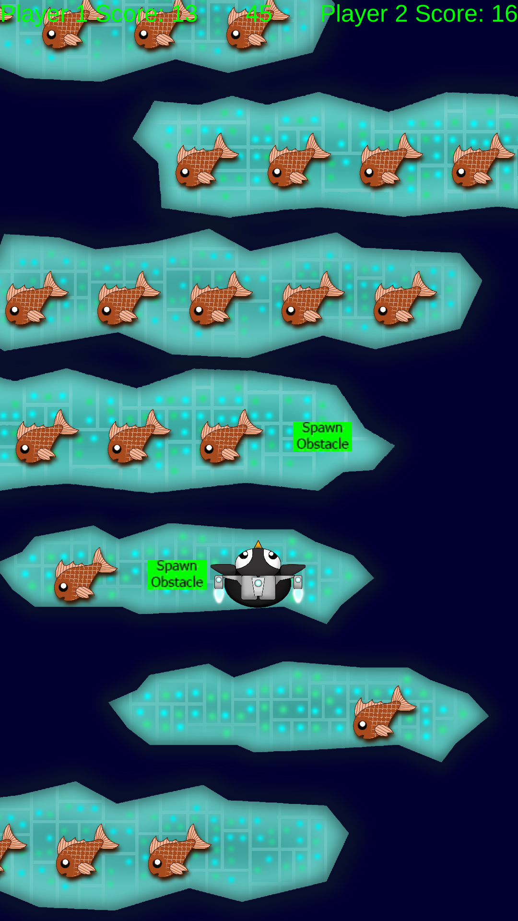
Playtesting
Players didn’t know how to play
Enjoyed all the power-ups
Enjoyed the gameplay time
Obstacles and power-ups were random
Pick-up values weren’t clear enough
Notes:
Dragos

Slide 9
Playtesting iteration
Instructions/tutorial
Variations of fish artwork
Symmetrical power-up layout
Notes:
Alice

Slide 10
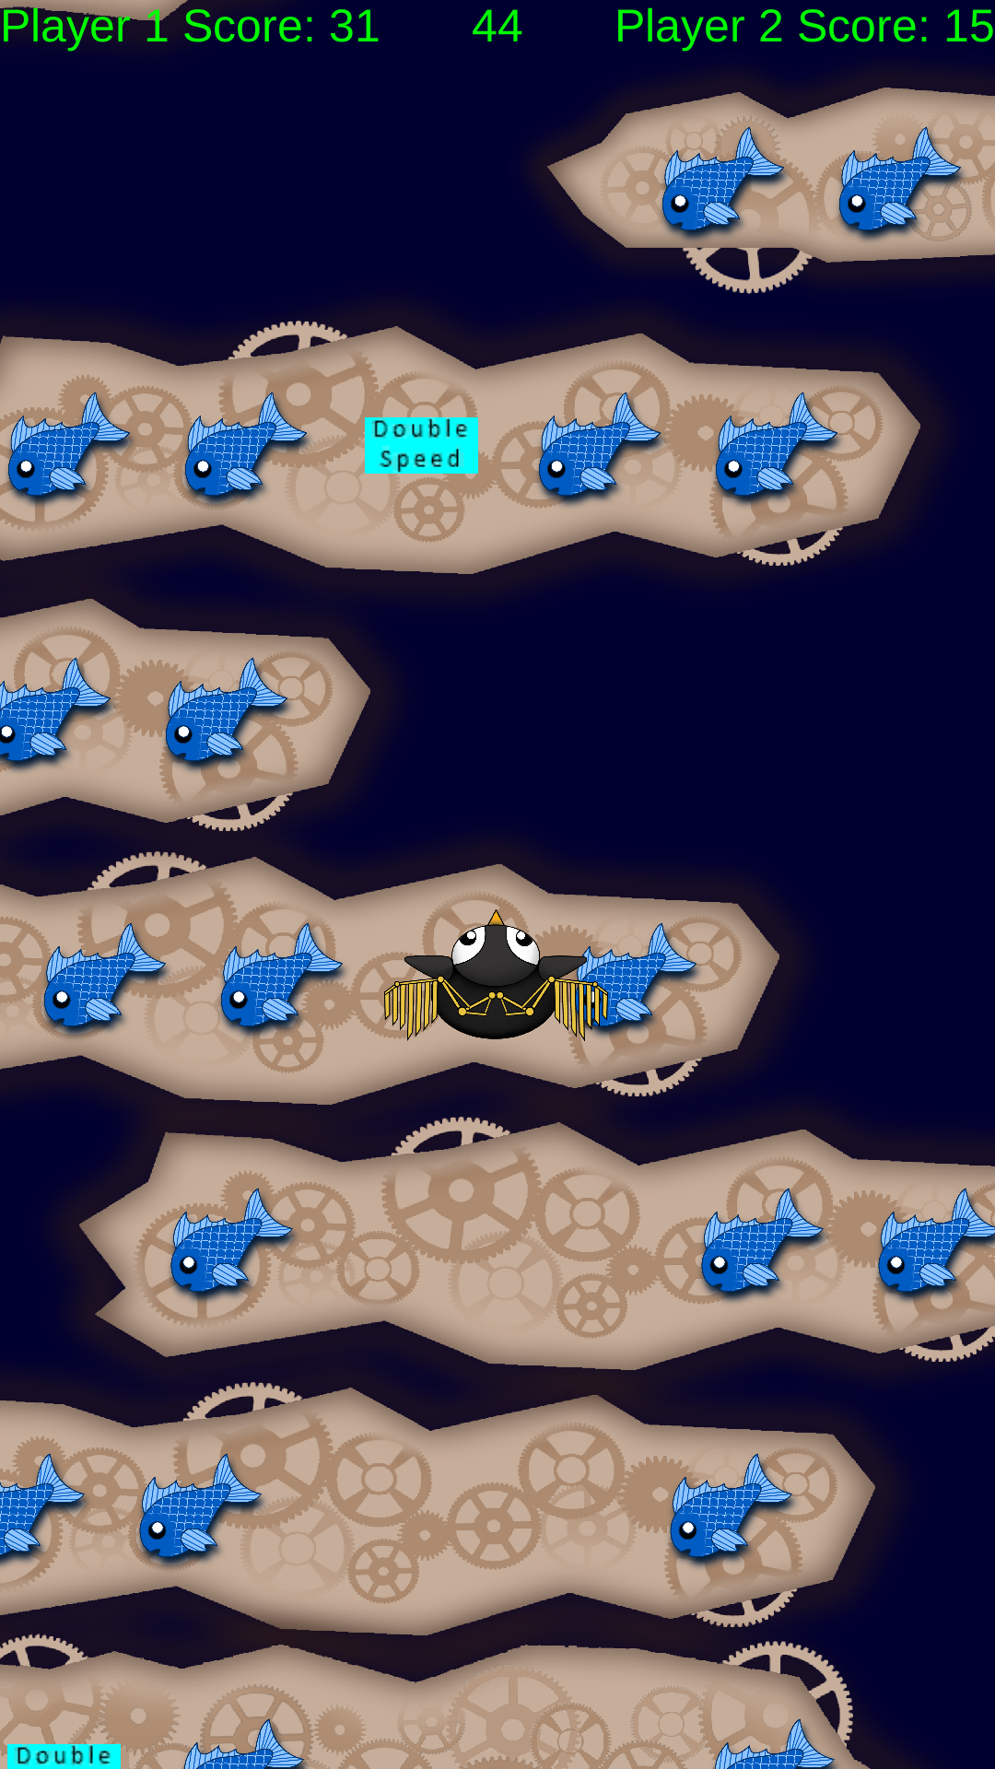
Playtesting
EMOTIONS –
Laughter
Amusement
Focus
Fiero
Schadenfreude
Notes:
Dragos

Slide 11
Design
How to implement design methods into a game
The importance of playtesting
How to do informed research
How to balance a game
Notes:
Dragos

Slide 12
Programming
Notes:
Jordan and Ken

Slide 13
Management
Set deadlines for tasks
Voice record meetings
Notes:
Alice

Slide 14

Thanks for watching!
Any questions?
Notes:
Alice

